Slide 1

PROCESS MINING VIRTUAL INTERNSHIP
by
DEEPAK RAJ
Roll No. 214G1A3217
Department of Computer Science and Engineering (Data Science)
Srinivasa Ramanujan Institute of Technology
(Affiliated to JNTUA & Approved by AICTE) (Accredited by NAAC with ‘A’ Grade & Accredited by NBA (EEE, ECE & CSE)
Rotarypuram Village, B K Samudram Mandal, Ananthapuramu – 515701.
2023 - 2024

Slide 2

Contents
Course Objective
Introduction
Technology
Applications
Modules
Real Time applications
Learning outcomes
GitHub Link
Queries

Slide 3
Course objectives
To dicover,validate and improve workflows
Conceptualize process in terms of activities and cases

Slide 4
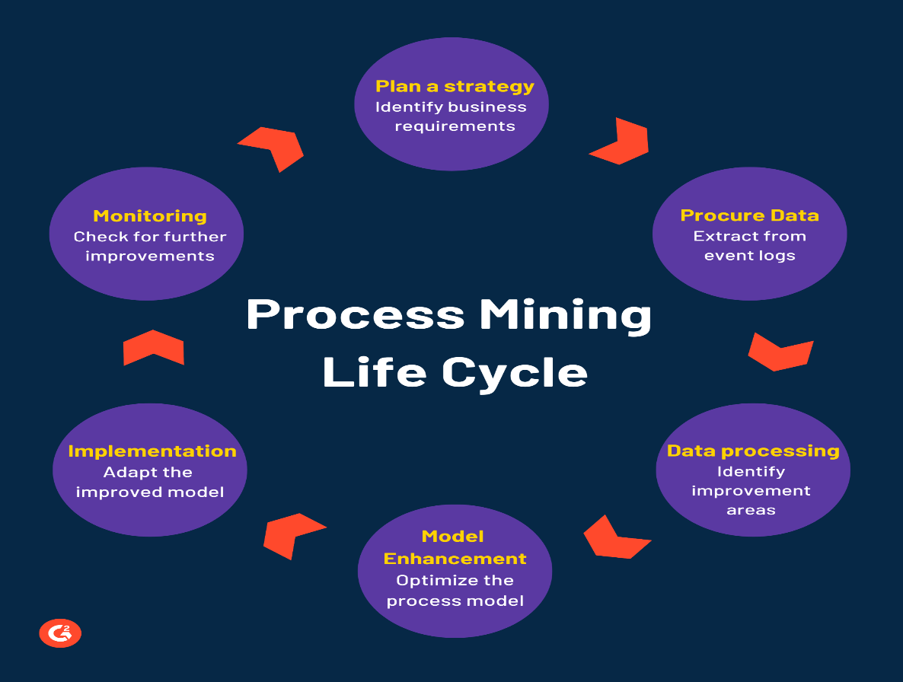
INTRODUCTION
PROCESS MINING ?
Process mining is a process management technique. It aims to discover, monitor and improve process flows by extracting readily available knowledge from information systems event logs.
Process mining provides companies with complete visibility into how processes really work.
PROCESS MINING LIFE CYCLE
Planning a strategy by identifying business goals and process requirements
Evaluating the process data and event logs to study the workflow
Identifying optimization potentials by process automation or relocation of resources
Conducting conformance checks to optimize the actual process model
Adapting the optimized model by implementing the necessary solutions
Reviewing the applied changes and monitoring for further improvement

Slide 5
Technologies
Process Mining Technologies
App templates
With the Process Mining service in Automation Cloud, you can create new process apps based on process-specific app templates. An app template contains a predefined set of dashboards and KPIs for process analysis and can be used as the starting point for creating your process apps. If available, an app template can include a built-in connector for a specific combination of a process and source system
2.Extracting and loading data
When creating a process app, you can upload data from .csv or .tsv files, or you can set up a connection to a source system using the extraction tools C Data Sync or Theobald Xtract Universal.
3. Dashboard editor
After creating a process app from an app template, you can edit the dashboards to customize the process app to your business needs. The Dashboard editor provides various options to create different views, and to organize, group, and filter data.

Slide 6
Technology
Process Mining Algorithms
The mining algorithm determines how process models are created. The best known categories are:
Deterministic algorithms: Determinism means that an algorithm produces only defined and reproducible results. It always delivers the same result for the same input. The deterministic algorithm was one of the first algorithms capable of handling concurrency. It takes an event log as input and computes the order relation of the events contained in the log.
Heuristic Algorithms: Heuristic mining also uses deterministic algorithms. However, they refer to the frequency of events and traces to reconstruct a process model. A common problem in process mining is that real-world processes are very complex and their discovery leads to complex models. This complexity can be reduced by neglecting rare paths in the models.

Slide 7
Applications
Celonis
Explanation: Celonis is a leading process mining platform that helps organizations visualize and analyze their processes using data from various systems. It offers process discovery, conformance checking, and performance analysis.
Features
Process Discovery: Automatically creates process models by analyzing event logs ,allowing you to visualize how processes are executed in reality.
Performance Analysis: Measures process efficiency,and provides insights for optimization.
Benefits: Celonis enables organizations to reduce inefficiencies, enhance efficiency, and make data-driven decisions.

Slide 8
Applications
Disco (Fluxicon):
Explanation: Disco is known for its user-friendly interface and offers comprehensive process mining capabilities.
features
User-Friendly Interface: Designed for ease of use and accessibility, making it suitable for various users.
Process Visualization: Generates process maps and diagrams that visually represent actual process flows.
Benefits: Disco provides a simple yet powerful toolset .
PROM
Explanation: Prom is an open-source process mining toolset used in both research and industry.
Features
Plugin-Based Architecture: Offers a wide range of plugins for different process mining tasks, allowing users to choose specific techniques.
Flexibility: Allows customization and experimentation with various process mining algorithms.

Slide 9
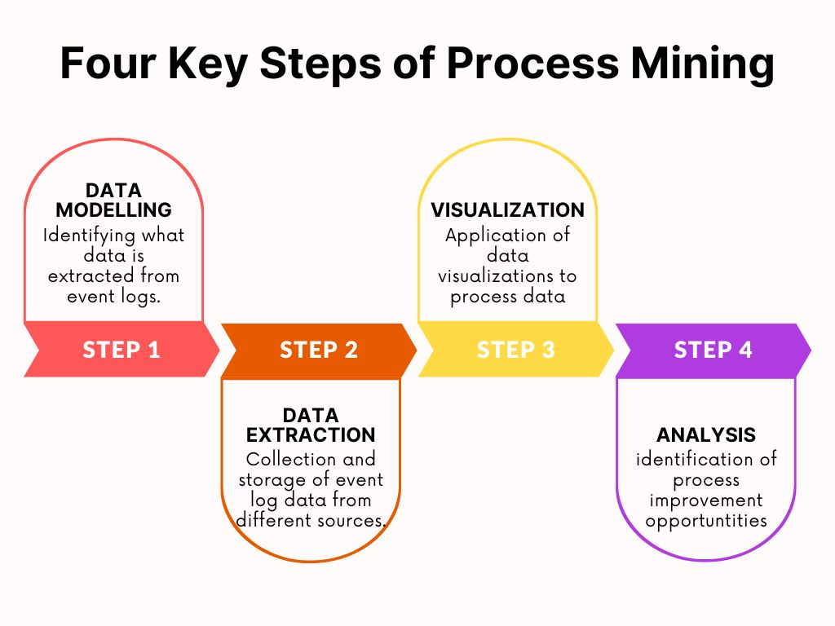
Modules
Celonis process mining fundamentals

Slide 10
Modules
Process Query Language.
PQL is the important component in process mining.
It is different from the SQL. It is designed based on requirements .If we give a question to it, it processes the data and gives the meaningful answer.
Design goals and the history of the PQL:
1.Simplicity:Easy to use and translates the complete process questions into data queries.
2.Flexibility:Formulates any question, regardless of the process.
3.Event log centered: supports process mining functionalities.
4.Business Focus : Combine process Mining and business intelligence capabilities.
5.Frontend interaction: Support of a graphical user interface(GUI).
PQL are executed in visual and code editors.

Slide 11
Real time Applications
Areas where process mining can be actively applied include the following
Healthcare Process Improvement: In healthcare, process mining can be applied to analyze patient treatment pathways, identify variations, and optimize resource allocation in real- time. This can lead to improved patient care and reduced wait times.
Manufacturing Process Analysis: Process mining can monitor and analyze manufacturing processes in real-time to ensure that production is running smoothly, detect anomalies or deviations from the standard process, and make immediate adjustments to prevent defects or disruptions.
Financial Transaction Monitoring: Process mining can be used in the financial sector to monitor and detect fraudulent activities in real-time. By analyzing transaction logs, it can identify patterns of suspicious behavior and trigger alerts for further investigation.
IT Service Management: Process mining can help IT departments optimize their service management processes by monitoring the flow of IT service requests, identifying bottlenecks, and streamlining incident resolution and request fulfillment

Slide 12
Learning outcomes
Gain an overall understanding of basic Process Mining concepts.
Become familiar with Mining core services and tools.
Learn the architectural principles of the process Mining.
Understand and be able to explain ProcessMining and compliance measures.

Slide 13
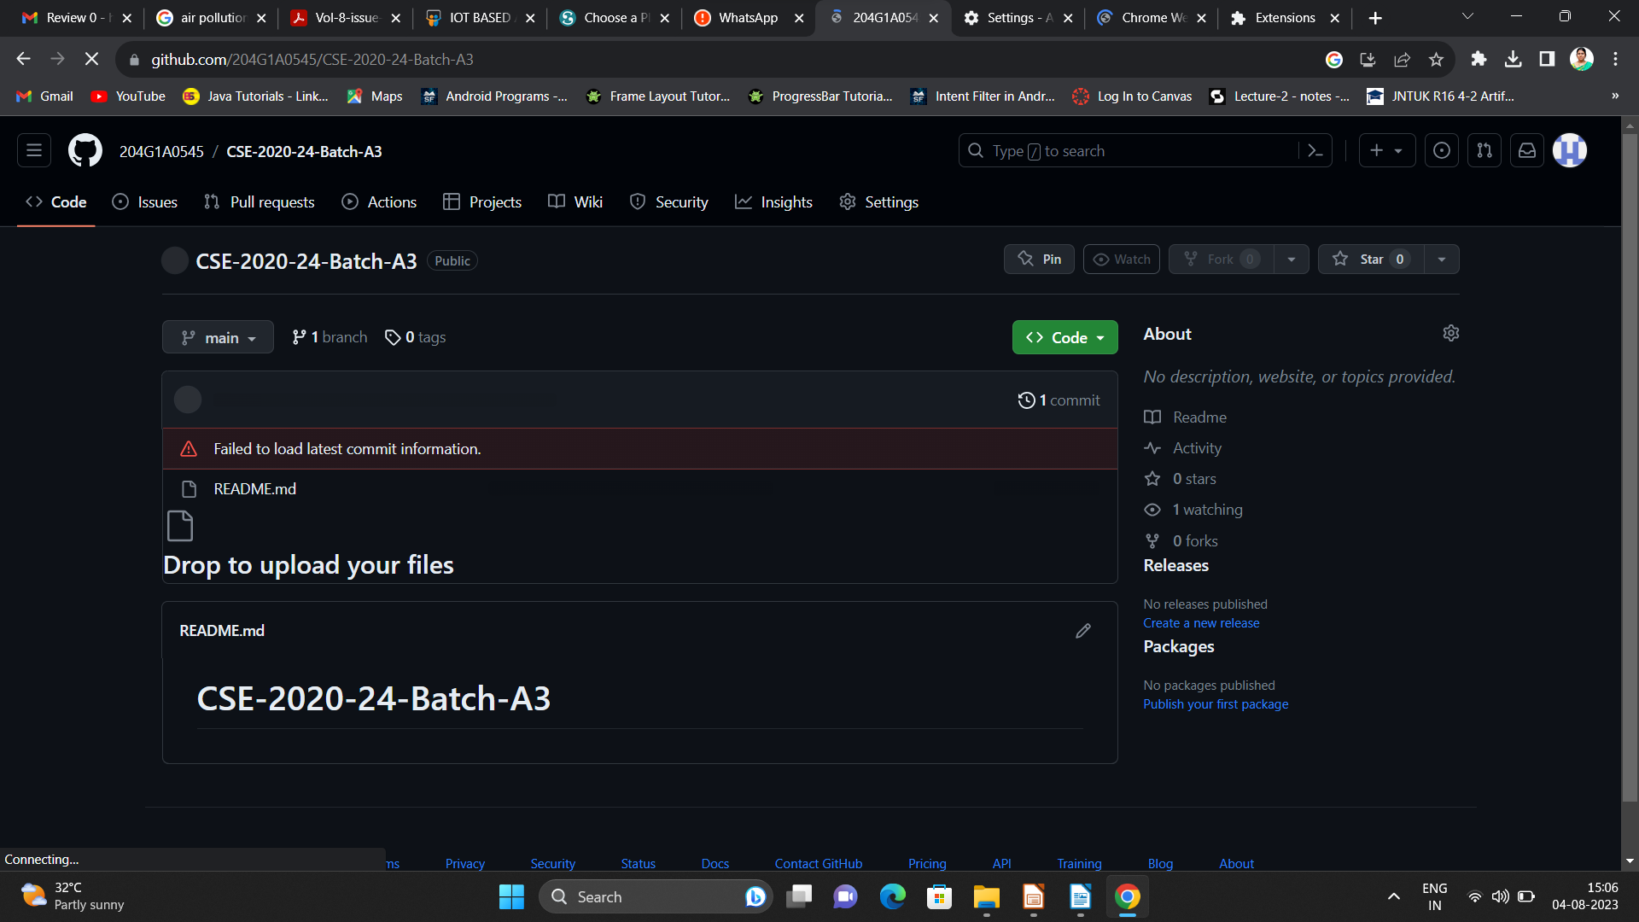

Git Hub Dashboard
Repository Name Like: Summer Internship - I
Under that include document, presentation and Certificate(Pdf).

Slide 14
Any Queries?

Slide 15
Thank You!!!

